Slide 1

A End-Semester M.Tech Seminar Presentation on Big Data Analysis for Data management with AWS and Hadoop
Madan Mohan Malaviya University of Technology, Gorakhpur
Presented By:-
Shivani Gupta
(2019023117)
M.Tech(2nd year)
Under the Guidance of:-
Mr. Rohit Kumar Tiwari
Asst. Professor
Department of Computer Science & Engineering
Madan Mohan Malaviya University of Technology, Gorakhpur-273010

Slide 2
Content:
Madan Mohan Malaviya University of Technology, Gorakhpur
Introduction
Literature Survey
Problem Statement
Problem related to Volume
Big Data and HDFS protocol
Result Analysis
Conclusion
References

Slide 3

Introduction
Madan Mohan Malaviya University of Technology, Gorakhpur
Big Data is a field that treats ways to analyse, systematically extract informations from, or otherwise deal with data sets that are too large or complex to be dealth with by traditional data processing application software.
“Big data” refers to datasets whose size is beyond the ability of typical database software tools to capture, store, manage, and analyze.
Related Issues:-
Lack of proper understanding of Big Data.
Data growth issues.
Confusion while Big Data tool selection.
Lack of data professionals.
Security of data.
Integrating data from a variety of sources.

Slide 4

Motivation of work:
Madan Mohan Malaviya University of Technology, Gorakhpur
Many Organizations can use Big Data analytics systems and software to make data-driven decisions that can improve business-related outcomes. The benefits may include more effective marketing, new revenue opportunities, customer personalization and improved operational efficiency.
With an effective strategy, these benefits can provide competetive advantages over rivals. Instead of using one large computer to process and store the data, Hadoop allows clustering commodity hardware together to analyze massive data sets in parallel.
Amazon EMR makes it easy to create and manage fully configured, elastic clusters of Amazon EC2 instances running Hadoop and other applications in the Hadoop ecosystems.

Slide 5

Literature Survey
Madan Mohan Malaviya University of Technology, Gorakhpur
In 2011, Gartner an information technology research and advisory company defined big data as growth challenges focus on information volume, variety and velocity [1].
In [2], Volume is defined as increasing the amount of data. Velocity is defined as the speed of data at which data flow in or out of the system. Variety is defined as various data types and sources. There are many frameworks to perform operation on big data. One of them is Apache Hadoop framework.
The most popular description of big data thus far is the ‘‘3V” model, where ‘‘3V” refers to volume, variety, and velocity [3].
Volume literally means that typical big data have particularly large data volume. For example, mobile phone call records usually have 70 million data entries [4].

Slide 6

Problem Statement
Madan Mohan Malaviya University of Technology, Gorakhpur
To build an architecture which handles that much amount of Data without any issue and with much low cost.

Slide 7
Problem related to ‘Volume’
Madan Mohan Malaviya University of Technology, Gorakhpur
Each day, the world produces 2.5 quintillion bytes of data. That is 2.3 trillion gigabytes.
By 2021, we will have created 40 zettabytes of data, which is 43 trillion gigabytes.
Most companies already have, on average, 100 terabytes of data stored each.
Facebook users upload that many data daily.
Walmart alone processes over a million transactions per hour.

Slide 8
Big Data
Madan Mohan Malaviya University of Technology, Gorakhpur
Relational Database Management system and desktop statistics and visualization packages often have difficulty handling big data. The work instead requires"massively parallel software running on tens, hundreds, or even thousands of servers". What is considered "big data“ varies depending on the capabilities of the users and their tools, and expanding capabilities make Big Data a moving target.
Challenges include analysis, capture, data curation, search, sharing, storage, transfer, visualization, and information privacy.
There are 7 V’s of Big Data:
Volume.
Velocity.
Variety.
Value.
Visualization.
Variability.
Varacity.

Slide 9
Hadoop (HDFS)
Madan Mohan Malaviya University of Technology, Gorakhpur
Hadoop is an open source, Java based framework used for storing and processing big data. The data is stored on inexpensive commodity servers that run as clusters. It’s distributed file system enables concurrent processing and fault tolerance (FT). Developed by Doug Cutting and Michael J. Cafarella, Hadoop uses the MapReduce programming model for faster storage and retrieval of data from its nodes. The framework is managed by ‘Apache Software’ foundation and is licensed under the ‘Apache License-2.0’.
HDFS:
HDFS is a distributed, scalable, and portable file system written in Java for the Hadoop framework. Each node in a Hadoop instance typically has a single ‘NN’; a cluster of ‘DN’ form the HDFS cluster. The situation is typical because each node does not require a DN to be present. Each DN serves up blocks of data over the network using a block protocol specific to HDFS. The file system uses the TCP/IP layer for communication.
Clients use RPC to communicate between each other. HDFS stores large files (an ideal file size is a multiple of 64 MB).

Slide 10


Madan Mohan Malaviya University of Technology, Gorakhpur
Architecture of Hadoop
Fig:1

Slide 11
Tools and System Configuration:
Madan Mohan Malaviya University of Technology, Gorakhpur
Description | Requirement
Terminal | Linux
RAM | 4 GB
Hard Disk | 500GB
Processor | Intel Core i3 CPU @ 2.4 GHz
OS | 64-bit Linux (RedHat)
Language | XML
Service Provider | AWS
Software | Hadoop (HDFS)
Fig:2

Slide 12
Madan Mohan Malaviya University of Technology, Gorakhpur
Implementation Details with AWS:
Launch an instance as Master-Node or NN.
Launch several instances as Slave-Node or DN.
Launch one instance as Client Node.
Connect all DN’s to a NN.
How storage is contributed through DN’s.
How master node can read data from any of the slave node.
Here, we show you all that if any of the slave node is disconnected then how master node can take data and from where it is taking.
Download the AWS CLI or work on Linux Terminal.
Create a Key-Pair and Security Group.
Create an EBS volume of 1GB.
Attach the above created EBS volume to the instance.

Slide 13
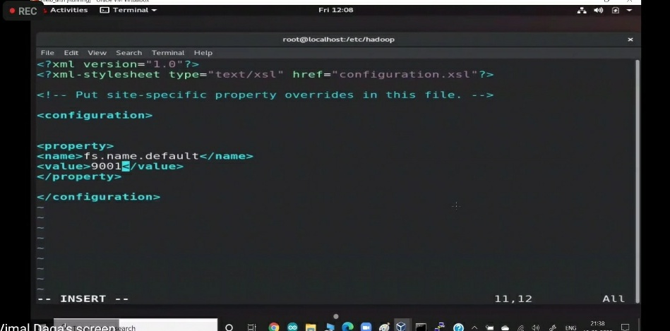
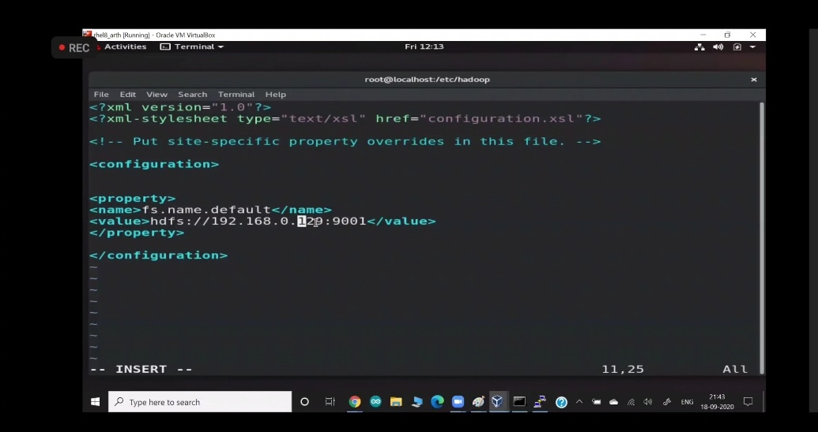
Madan Mohan Malaviya University of Technology, Gorakhpur
Result Analysis
Fig- 2 How has the connection done for NN and DN.

Slide 14
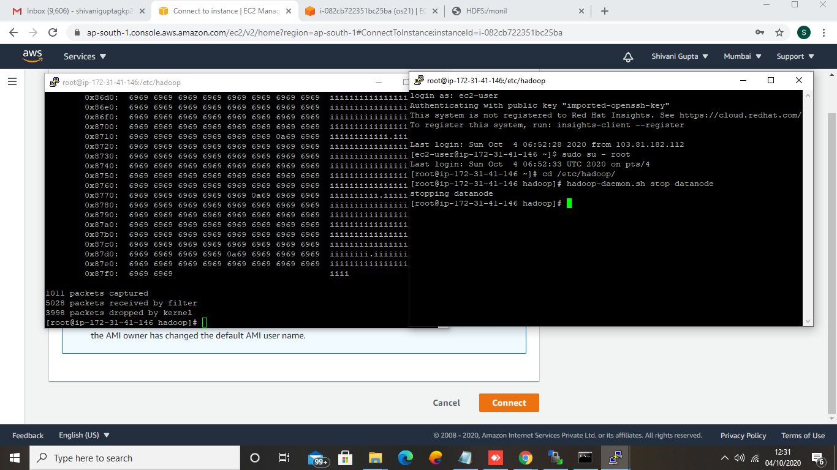
Cont...
Madan Mohan Malaviya University of Technology, Gorakhpur
Fig-3 How we can see the data of any of the DN.

Slide 15
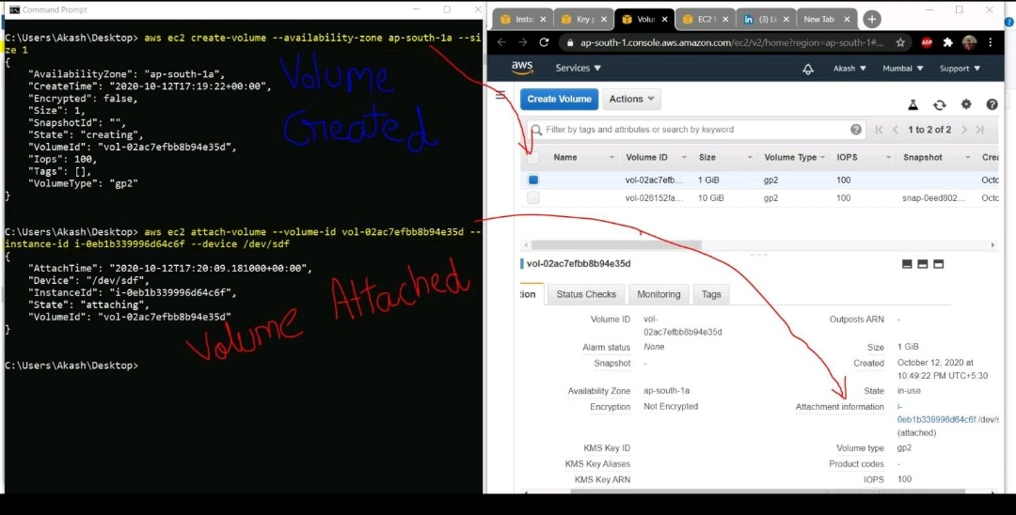
Cont...
Madan Mohan Malaviya University of Technology, Gorakhpur
Fig- 4 How we can create the EBS volume and attach it to the instances via using AWS CLI commands.

Slide 16
Conclusion:
Madan Mohan Malaviya University of Technology, Gorakhpur
Big data is a term for massive data sets having large, more varied and complex structure with the difficulties of storing, analyzing and visualizing. The process of research into massive amounts of data to reveal hidden patterns named as big data analytics. These useful informations for companies or organizations with the help of gaining richer and deeper insights. For this reason, big data implementations need to be analyzed and executed. This work presents an overview of big data's content, scope, samples, methods, advantages and challenges and discusses privacy concern on it and also we have shown the implementation of solution Big Data problem with respect to volume and velocity.
Future Plan:
We will try to recover some more challenges of Big Data via using AWS and Hadoop framework.

Slide 17
References
Madan Mohan Malaviya University of Technology, Gorakhpur
[1]. Warren, J., & Marz, N. (2015). Big Data: Principles and best practices of scalable realtime data systems. Simon and Schuster.
[2]. Long, Y., & Thill, J. C. (2015). Combining smart card data and household travel survey to analyze jobs–housing relationships in Beijing. Computers, Environment and Urban Systems, 53, 19-35.
[3]. Crampton, J. W., Graham, M., Poorthuis, A., Shelton, T., Stephens, M., Wilson, M. W., & Zook, M. (2013). Beyond the geotag: situating ‘big data’and leveraging the potential of the geoweb. Cartography and geographic information science, 40(2), 130-139.
[4]. Gao, S., Li, L., Li, W., Janowicz, K., & Zhang, Y. (2017). Constructing gazetteers from volunteered big geo-data based on Hadoop. Computers, Environment and Urban Systems, 61, 172-186.
[5]. McNulty, E. (2014). Understanding Big Data: the seven V’s. Dataconomy. URL: http://dataconomy. com/2014/05/seven-vs-big-data.

Slide 18
Thank You

